Slide 1




Dynamic Host Configuration Protocol(DHCP)
A presentation on

Slide 2
Introduction
DHCP (Dynamic Host Configuration Protocol) is a system that automatically assigns IP addresses to devices on a network.

Slide 3
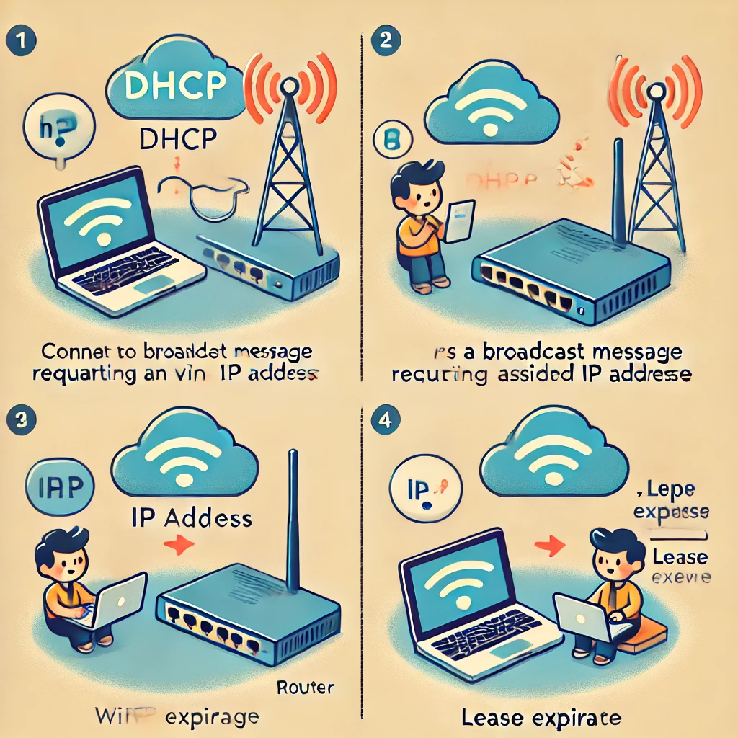
Think of it as a "phone book" for your network that assigns unique "phone numbers" (IP addresses)
to devices like computers, smartphones, or printers so they can communicate with each other.

Slide 4
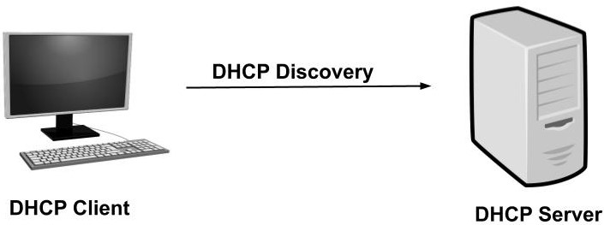
DHCP Discovery

Slide 5
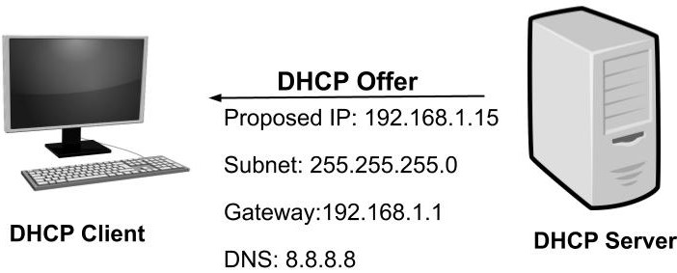
DHCP Offer

Slide 6
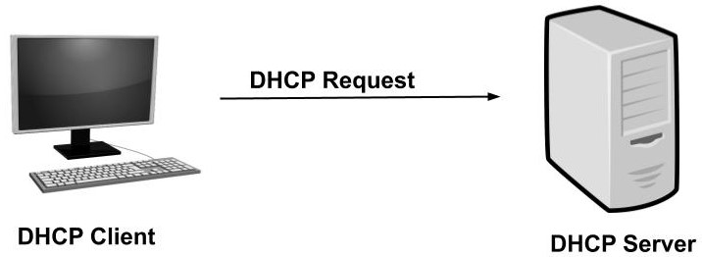
DHCP Request

Slide 7
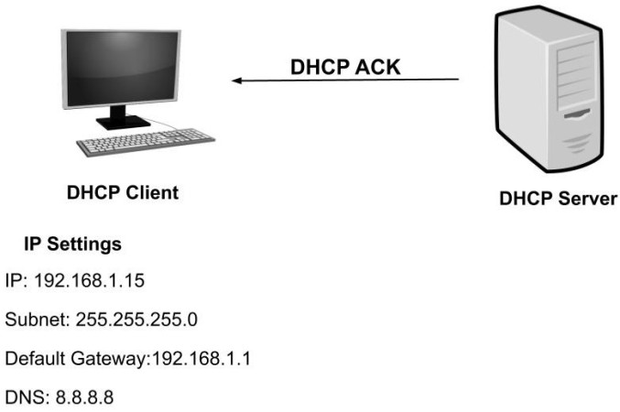
DHCP Acknowledgement

Slide 8
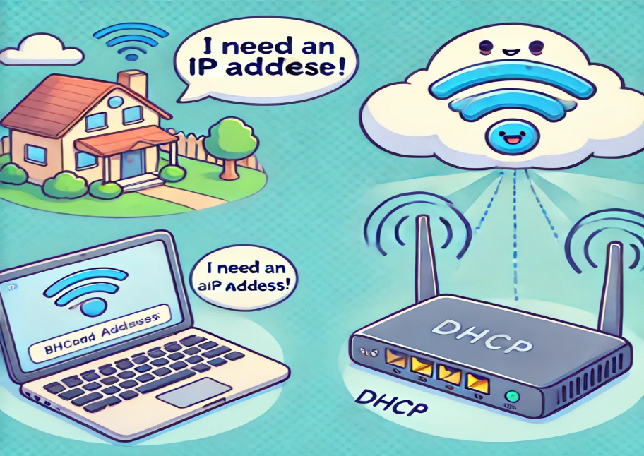

Gather Your Research using Researcher
2
1
1. Imagine you connect your laptop to Wi-Fi. The laptop doesn’t know its IP address yet, so it sends out a message saying, “I need an IP address!”
2. There’s a device on the network called a DHCP server (usually part of your router). It listens for requests and replies, “Here’s an IP address you can use.”

Slide 9
3
4
3. the laptop successfully receives its IP address from the router and connects to the network.
4. the laptop renews its IP address lease from the router as the lease time is about to expire.

Slide 10

Why is it useful?
Saves time
Avoids conflicts
Flexible

Slide 12


QR code for GitHub Repo for this presentation

